Slide 1

Note: The data and information in this document is reflective of a hypothetical situation and client. This document is to be used for KPMG Virtual Internship purposes only.
Sprocket Central Pty Ltd
Data analytics approach
[Division Name] - [Engagement Manager], [Senior Consultant], [Junior Consultant]

Slide 2
Note: The data and information in this document is reflective of a hypothetical situation and client. This document is to be used for KPMG Virtual Internship purposes only.
Agenda
Introduction
Data Exploration
Model Development
Interpretation

Slide 3
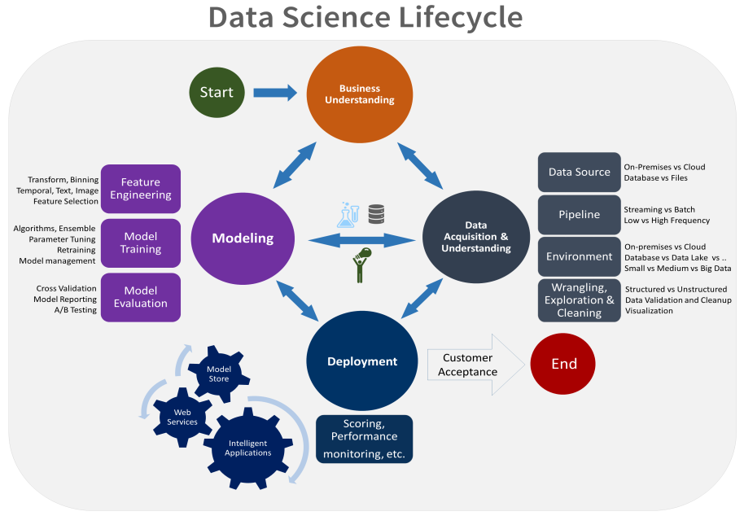
Note: The data and information in this document is reflective of a hypothetical situation and client. This document is to be used for KPMG Virtual Internship purposes only.
Introduction
COMPARATIVE REPORT ON THE DATA EXPLORATION, MODEL DEVELOPMENT, AND INTERPRETATION OF THE GIVEN DATA
This slide explains the breakdown of event on data exploration, model development and data interpretation by employing the fundamental understanding on the concepts of data distributions, feature engineering, data transformations, modeling, results interpretation and reporting. The diagram provided gives an over view of the data science model deployed that is data exploration, data modeling and interpretation of data
Place any supporting images, graphs, data or extra text here.

Slide 4
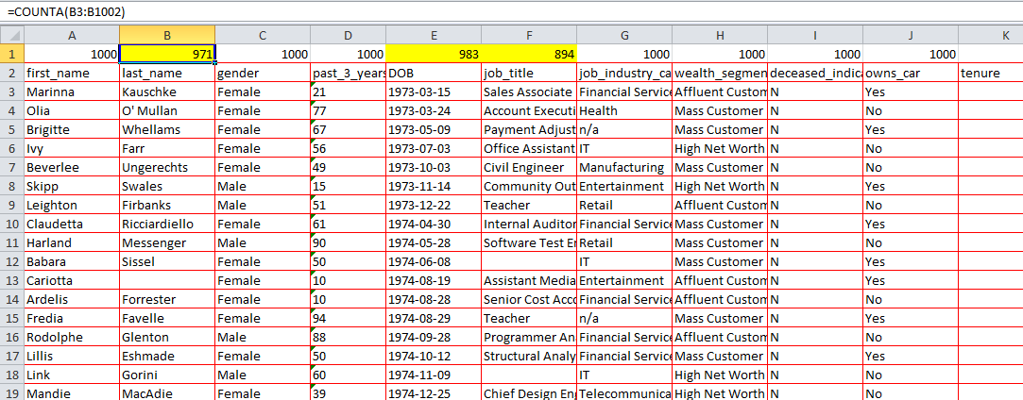
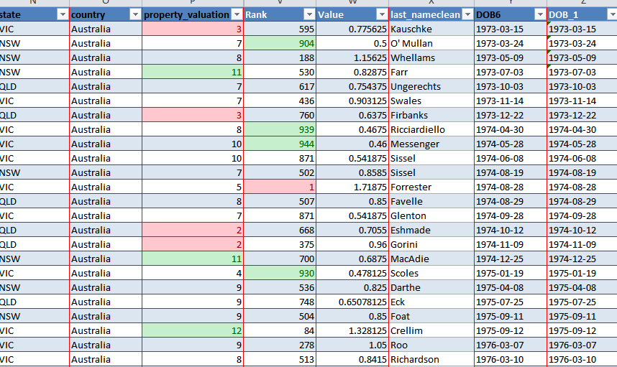
Note: The data and information in this document is reflective of a hypothetical situation and client. This document is to be used for KPMG Virtual Internship purposes only.
Data Exploration
The Exploration of Data Done using excel
During the exploration of Data the given data was critically studied hence three column of new customer data was found to contain missing values, the data was also checked against duplicate values, hence data cleaning, resolution of missing data and restructuring of data was done. The images supplied here show the new customer data where the column with missing files were highlighted with yellow and the second image shows the same data but now corrected and cleaned.
Place any supporting images, graphs, data or extra text here.

Slide 5
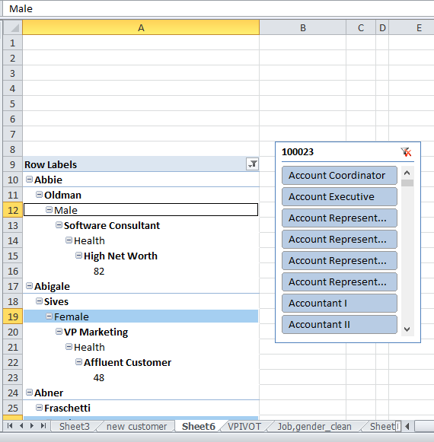
Note: The data and information in this document is reflective of a hypothetical situation and client. This document is to be used for KPMG Virtual Internship purposes only.
Model Development
Model development using Excel
After the data had been explored and made clean some of the variables created were used to develop models. Here the excel functions were of great use the image sample provided in this slide shows the row sect of the major data of each customer. For the purpose of model development some variables were created such as the age from the date of birth column given and some statistical analysis were also carried out to enhance hypothetical conclusion and the interpretation of data.
Place any supporting images, graphs, data or extra text here.

Slide 6
Note: The data and information in this document is reflective of a hypothetical situation and client. This document is to be used for KPMG Virtual Internship purposes only.
Interpretation
Data Interpretation using Excel and Tableau
After the data exploration and modeling the data was then used for visualization and hence insight was given by visualizing the data using tableau which helped to draw conclusion on facts to help strategize on the customer relation and satisfaction, by visualizing the data it could be seen that the average population making up the customer list is more of the people with age a-little above the average age (47) and the young age(18 to 27) category of about 50 below, with little old or extremely old category. Also coming up with a statistical model by comparing the age, tenure, purchase for 3 years, property valuation and wealth segment a customer named Luvodico Juster happens to be the targeted customer , though being an affluent customer not with high net worth but being an environmental scientist who most likely requires a bicycle to carry out some of his activities and being just 27 years, has a record of 93 purchase though the highest purchase is about 99 which most of those with the record are 40 years above except from Pace Clemont a 29 year old High net worth media manager which I could have consider as the target customer or even Clarine Piecha but considering some other variables statistically Juster obtained a better record than them.

Slide 7
Note: The data and information in this document is reflective of a hypothetical situation and client. This document is to be used for KPMG Virtual Internship purposes only.
Working on this project the materials used were majorly those supplied by Kpmg inside sherpa, while aiding my knowledge as a beginner other open sources were of great use and these are:
Google.com
Youtube.com

Slide 8
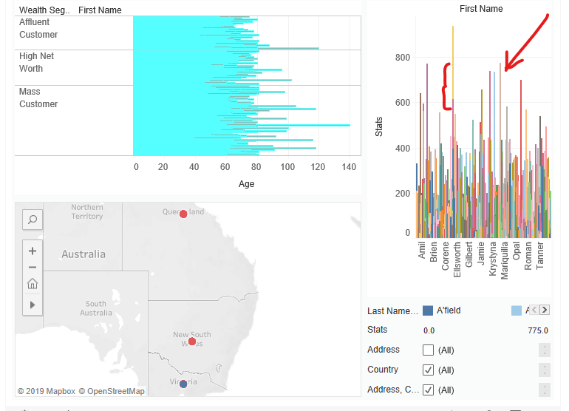
Note: The data and information in this document is reflective of a hypothetical situation and client. This document is to be used for KPMG Virtual Internship purposes only.
Appendix
This is an optional slide where you may place any supporting items.
Place any supporting images, graphs, data or extra text here.
Notes:
The bar above the 800 range is a bar for 3 persons who answers the-same name so the highest range is that of Juster with 750 statistical value.

